Slide 1
.NET

Slide 2

Learn. Imagine. Build. .NET Conf September 19-21
Save the date!
www.dotnetconf.net
Notes:
Maybe put this in the beginning….

Slide 3
.NET Core 2.0 Released!
Download today!
www.dot.net/core

Slide 4
.NET Core 2.0
Fastest version of .NET ever
More APIs
More project templates
More distros
Simplified packaging
New and improved Visual Studio tooling
Visual Studio for Mac support
Notes:
Performance – From profile guided optimizations to faster JIT compiler to the numerous performance improvement made by the community in the .NET Core libraries, .NET Core 2.0 is the fastest version of .NET ever.
Expanded Libraries - .NET Core 2.0 implements the .NET Standard 2.0 which has expanded the API surface area so that code and binaries can be shared across runtimes and workloads.

Slide 5

Notes:
Looks like this will release on 8/16 according to Red Hat.

Slide 6






Thank you to all our contributors!
Community PRs by month
“Samsung is embracing .NET because it is a completely open source project.” — Samsung
"ASP.NET is open source, that allows us to contribute back to it if we have any performance issues which Microsoft review and together we make a better product.“
— Illyriad Games

Slide 7


.NET Standard
WINDOWS
DESKTOP
CLOUD MICROSERVICES
WINDOWS UWP
IOS, ANDROID
GAMES/ 3D
Visual Studio
.NET STANDARD
Visual Studio for Mac
INFRASTRUCTURE
COMPILERS
LANGUAGES
RUNTIME COMPONENTS
Visual Studio Code
.NET Standard allows sharing code, binaries, and skills between .NET client, server, and all flavors
.NET Standard provides a specification for any platform to implement
All .NET runtimes provided by Microsoft implement the standard

Slide 8
.NET Standard 2.0 Released!
Has much bigger API surface
Extended to cover intersection between .NET Framework and Xamarin
Also makes .NET Core 2.0 bigger as it implements .NET Standard 2.0
+20K
More APIs than
.NET Standard 1.x
Can reference .NET Framework libraries
Compatibility shim allows referencing existing .NET Framework binaries
No recompile required – also covers existing NuGet packages
Limited to libraries that only use APIs that are available for .NET Standard
~70%
of NuGet packages
are API compatible

Slide 9
APIs in .NET Standard 2.0
XML
XLinq • XML Document • XPath • Schema • XSL
SERIALIZATION
BinaryFormatter • Data Contract • XML
NETWORKING
Sockets • HTTP • Mail • WebSockets
IO
Files • Compression • MMF
THREADING
Threads • Thread Pool • Tasks
CORE
Primitives • Collections • Reflection • Interop • Linq

Slide 10
Demo: .NET Standard
Abisoye Falabi
@falabs

Slide 11
Performance improvements in .NET Core 2.0
Base class libraries (CoreFX)
The community has submitted many of these performance improvements
RyuJIT – Just-in-time IL compiler
Benefits .NET Core and .NET Framework
Profile-guided optimization
Improvements to generate better optimized code for native components
“Using the same-size server, we were able to go from 1,000 requests per second per node with Node.js to 20,000 requests per second with .NET Core.“ — Raygun
https://www.microsoft.com/net/customers
Notes:
https://blogs.msdn.microsoft.com/dotnet/tag/performance/

Slide 12
Visual Studio 2017 Version 15.3
Download today!
www.visualstudio.com

Slide 13
betterTogether = .NET Core + Visual Studio 2017
Support for .NET Core 2.0 and .NET Standard 2.0
Install the .NET Core 2.0 SDK and the Visual Studio features will light up
Simplified and portable project files across CLI & Visual Studio family
Code navigation improvements
CI/CD support for containers
Notes:
Visual Studio 2017 now supports creating and running .NET Core 2.0 apps, just remember the SDK does not yet come as part of Visual Studio 2017, so you will need to download and install the .NET Core 2.0 SDK separately.
With the added support for .NET Core 2.0 in Visual Studio 2017 you can create .NET Core web and console applications, and .NET Core and .NET Standard class libraries using Visual Basic as well as C#
NET Framework and .NET Standard/Core interop: Users can now more seamlessly install or refer to .NET Core/.NET Standard libraries from .NET Framework projects and vice versa. No need to manually add interop NuGet packages – system does this for you automatically.
Build: Incremental builds for .NET Core is now turned ON by default.

Slide 14
Live Unit Testing for .NET Core
Maintain quality and test coverage as you code
Automatic test execution
Visualize code coverage in the IDE
Notes:
maintain quality and test coverage of your .NET Core apps and libraries during rapid development. See the results of your unit tests as you code to
Automatically execute impacted tests as you edit code and get real-time visual feedback on the test results. Ensure that your changes do not break the tests, simply by changing your code!
Live Unit Testing updates each line of code in the Visual Studio editor to show you whether the code you're writing is covered by unit tests and whether the tests that cover it are passing. See where you are missing tests to quickly decide which tests to create next.

Slide 15
Demo: Live Unit Testing
Kasey Uhlenhuth

Slide 16
Azure Functions & .NET Core
Visual Studio Tools for Azure Functions now ship in the box
Create pre-compiled C# functions
WebJobs attributes simplify function binding
Notes:
Visual Studio Tools for Azure Functions are now included as part of the Visual Studio installation. To get the tools, you need to make sure to install the Azure workload.
Create pre-compiled C# functions that provide better cold start performance than script based functions, and opens the entire eco-system of Visual Studio tools for class libraries including code analysis, unit testing, complete IntelliSense, 3rd party extensions, etc
Use WebJobs attributes to declare function bindings directly in the C# code rather than the separate function.json file

Slide 17
Demo: Azure Functions
Andrew Hall

Slide 18
Visual Studio for Mac version 7.1
Download today!
www.visualstudio.com

Slide 19
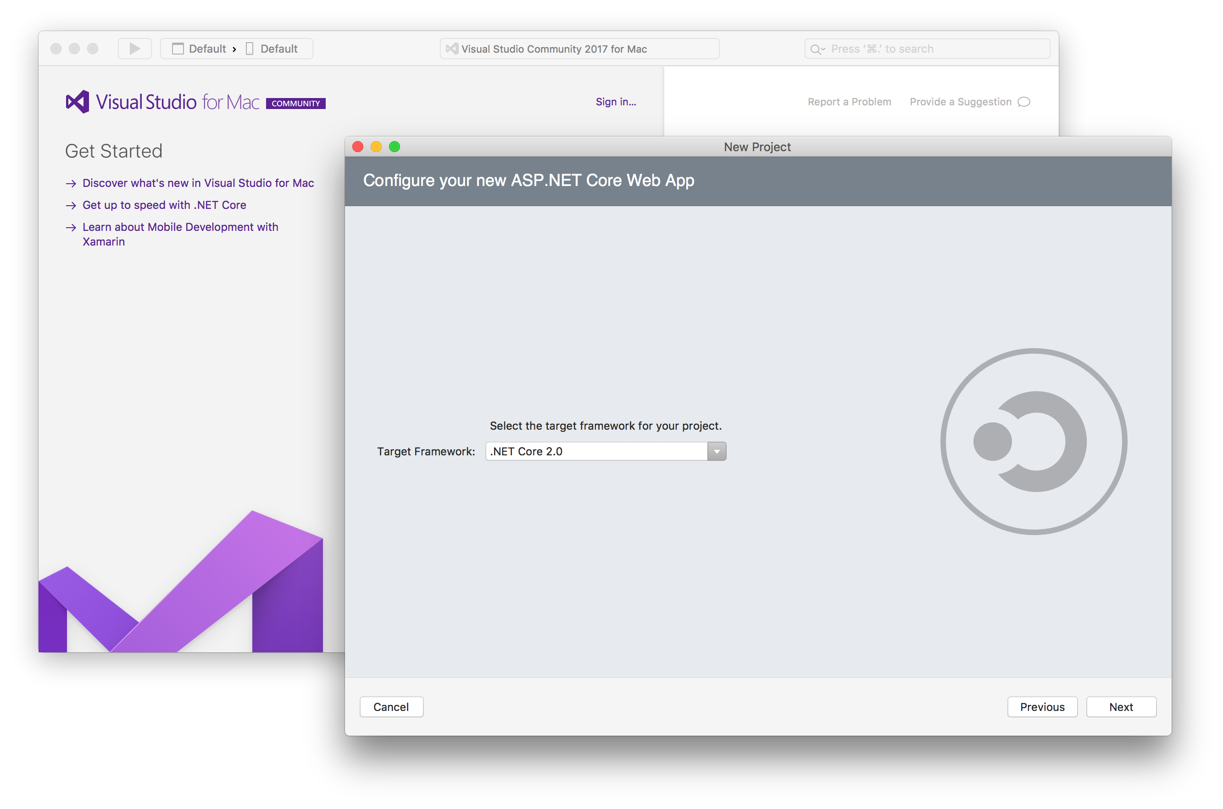
Visual Studio for Mac & .NET Core
.NET Core 2.0 support
Console
Web App
Web API
.NET Standard libraries

Slide 20
Demo: Visual Studio for Mac
James Montemagno

Slide 21
ASP.NET Core 2.0
Faster
Razor Pages
Razor support for C# 7.1
Azure Diagnostics & Live Analytics
Angular and React templates
Authenticator app support in templates

Slide 22
Demo: ASP.NET Core 2.0
Scott Hunter & Dan Roth

Slide 23
Entity Framework Core 2.0
Owned types
Table splitting
Global query filters
Scalar database function mapping (contribution)
LINQ implementation improvements
Performance improvements
DbContext pooling
Explicit compiled queries

Slide 24
Demo: Entity Framework Core
Diego Vega

Slide 25



Key Takeaways
API
.NET Standard 2.0
Performance
Visual Studio Tools
Expanded API surface area allows much more of your code and binaries to be shared across all .NET runtimes and workloads
.NET Core 2.0 is the fastest version of .NET ever
Visual Studio and Visual Studio for Mac latest updates fully support .NET Core 2.0

Slide 26
.NET Core 2.0
Download today!
www.dot.net/core

Slide 27
.NET

